Slide 1
Protocol and General Etiquette
Presented by:
Kedar Paudel

Slide 2
pksf/L u'0fL JolQm lgx'/G5 lg/Gt/ .
kmn]sf] j[Ifsf] xfFuf] gem's]sf] sxfF 5 / ..
slj lz/f]dl0f n]vgfy kf}8\ofn

Slide 3
“Many people are educated but not totally mannered.” - Anonymous
“Maturity doesn’t mean age; it means sensitivity, manners, and how you react.” - Anonymous
Politeness is the chief sign of culture. - Baltasar Gracian
“Your wealth is your good manners.” - Anonymous
“There are some things that money can’t buy, like manners, morals, and integrity.” - Anonymous
“People are people no matter where you go, they want to be valued.” - Cindy Grosso
“ Good manners will open doors that the good education cannot” - C. thomas

Slide 4
Protocol, Manner and Etiquette: simple understanding
Protocol, Manners and Etiquette are not only different words for the same meaning. However,
Manners: What to do it.
Etiquette: How to do it.
Protocol: When to do it.

Slide 5
Protocol
Protocol is about following correct procedures. It is the art of ensuring that official visits, meetings and functions are planned and conducted in accordance with a established set of rules that are formally, socially and culturally accepted and expected by the parties involved.
A protocol is a rule which describes how an activity should be performed, especially in the field of diplomacy.
A Protocol is a forms of ceremony and diplomatic etiquette observed by diplomats and heads of state.

Slide 6
Manner
It is an attitude of a person that sets of his/her traits.
Manners are an expression of inner character of a person.
The treatment of other people with courtesy and politeness, and showing correct public behaviour.

Slide 7
Etiquette
“The customary code of polite behaviour in society or members of a particular profession or group” -Oxford Dictionary
“Etiquette is what you are doing and saying when people are looking and listening. What you are thinking is your business.” -Virginia Cary Hudson
Etiquette is the customs or rules governing behaviour regarded as correct or acceptable in social or official life.
Etiquette is a conventional but unwritten code of practice followed by members of any of certain professions or groups.
Rules of etiquette are the guiding codes that enable us to practice manners.

Slide 8
Etiquette and manners are important aspects of the court system. They help to maintain the decorum of the court, ensure the fair and impartial administration of justice, and demonstrate respect for the rule of law.

Slide 9
Avenues of Etiquettes and Manners
Professional Etiquette
Meeting and Conversation
Dress Code
Body Postures
Language and communication
Social Functions
Respect to Culture
Table manner and meal etiquette
Other Dos and Do not (miscellaneous)

Slide 10
Judges’ Professional Etiquette
Courtroom Etiquette
Etiquette under prescribed Rules and Code of Conduct for Judges
Meeting and Conversation Etiquette
Social Etiquette

Slide 11
Professional Conduct of Judges
Be calm, composed, and respectful
Avoid anger, sarcasm, or ridicule
Start on time, be well-prepared
Dress professionally

Slide 12
सामाजिक शिष्टाचार
Societal Prestige
Public Scrutiny.
Minimize the Risk of Conflict with Judicial Obligations.
Compliance with the Code of Conduct.

Slide 13
Greetings: Handshake
Firmly with men and softly with women,
Should not use both hands or grab while shaking hands,
Always the senior extends hand for shake up. In case of women, a man should give hand if she extends her first,
Understand the culture of the guests
If the guests are from Muslim countries, women avoid shaking hands with men.

Slide 14
Exchange of Visiting Cards
Always carry visiting Cards in a Visiting Card case
Do not draw visiting cards from wallet
Follow the local tradition while giving away the cards

Slide 15
Dress Code (Cont..)
National dress
Lounge suit:
Dark combination (brown is generally not worn)
For women-either combination suit or national attire
Smart Casual:
One of the most common yet confusing.
Casual:
with gentle color paint and shirt/should consider the local weather condition
Picnic/outings
Colourful dress/jeans

Slide 16
Dress Code (Cont..)
Shoe:
Good quality leather shoes, generally laced on formal occasion
Women should try to avoid long pencil heel shoe. Heel shoe is preferred but moderately (2 inch).
Preferred black colour
Socks:
Generally preferred black colour
Coat button:
while standing, the coat should be buttoned and unbuttoned while seating. If the coat is of two buttons leave the lower button undone
If coat is three buttoned, the middle one should be buttoned
Black belt

Slide 17
Dress Code: some tips
Before starting to plan any outfit you should always consider these three things:
Where is the event held? If you haven’t been, look up the venue. You can judge a lot by its décor.
The demographic of attendees - who will be there?
Ask yourself whether what you’re wearing would be appropriate for another dress code. For example, if it is bordering on ‘cocktail’, then reconsider.

Slide 18
Social functions (Contd..)
Menu:
Table d’hote :
Table of the host, Fixed menu
Set menu for platter service (4 to 5 courses normal). There could be elaborate menu courses
A la Carte :
From the card
Choosing from menu
Buffet:
Display of items
Choose according to your taste

Slide 19
Social functions (Contd..)
Toasts
Either the wine or Champaign is served for toast
Raise your glass
Water glass should not be raised for toast
Non-alcohol drinkers can raise
eg: juice glass
After toast, should not keep glass without sip
There may be numbers of toasts, do not make empty of your glass

Slide 20
Social functions (Contd..)
Speech/Remarks
Generally short speech/remarks are made at the official banquet/dinner/luncheons
Even in informal settings, short remarks are made
Dessert
Tea/coffee
See off the guests

Slide 21
Social functions (Contd..)
Use of Napkin
Place a napkin on lap
Do not flap a napkin on the air
Do not wipe face by napkin
Use a napkin only for blot on mouth
Do not wipe the silverware by napkin
Place napkin on the chair if to leave the table for any reason
Place napkin on left after finishing the meal

Slide 22
Social functions (Contd..)
Pre-dinner drinks
whisky, gin, sherry (sweet/dry wine), Juice, red wine, white wine, soft drinks
Limit yourself for the drink
Over drink may loosen your tongue and body imbalance, which may invite yourself in an embarrassing situation.
Drink at the formal dinner
Fish/chicken-white wine/ red meat-red wine
Sweet wine or Champaign
After dinner
usually brandy, cognac are served.

Slide 23
Social functions (Contd..)
Table Manners
Arrangement of plates,
Side plates
Glasses
Knives, forks and spoons

Slide 24
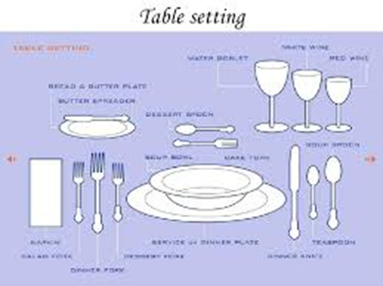
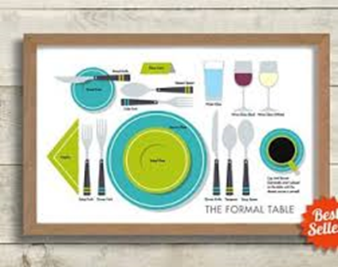
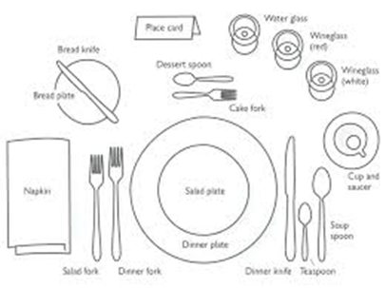

Slide 25
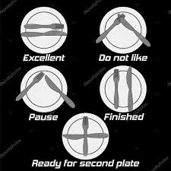
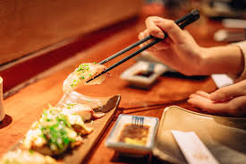
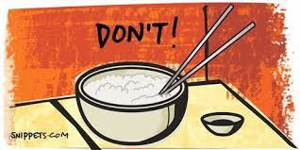

Slide 26
Dining Etiquette For Beginners.mp4

Slide 27
Social functions (Contd..)
Table Manners
Side plates are kept at the left hand side
Forks/knives are to be used from outside-in
Use of Napkin towels
Usually meals are served from the head table
Start eating after the host and chief guest start eating

Slide 28
Table Manner
Avoid the following actions:
Placing handbag/purse on the table
Gesturing with your knife or spoon
Putting food into mouth with a knife
Reaching across the guests to get a dish instead asking for passing it to you
Applying lipstick at the table
Do not pick at your teeth or put your fingers in mouth
Do not say “I don’t like this, or I hate that”

Slide 29
Table Manner
Do not mix food together
Do not pick up utensils or napkin dropped on the floor instead ask for another
Do not tilt or rock your chair. Maintain good posture
Don’t slurp while taking tea/coffee

Slide 30
Table Manner
Use the fork with your left hand and knife with the right
Should not make unpleasant sound while using knife and fork
Never speak with your mouthful or ask a question to a person sitting besides you just when the person has taken food in the mouth.
Do not chew with your mouth open
Do not gargle while drinking water
Do not poke your teeth with a toothpick or fingernail
At buffet, do not pile food on your plate

Slide 31
Using a Car
The Security or Protocol Officer seats in the front seat besides the driver
If the VIP is driving the car, his/her spouse should seat in the front seat and his/her subordinate or friends should be at the back seat
After the senior rides, the junior should take his/her seat

Slide 32
Response to Salami (Salute)
Civil Authority do not return a military salute
They acknowledge it with dignity and courtesy
Correct ways to respond is:
Slight inclination of Head: a gentle nod of the head
Brief eye contact with a composed posture: often combined with a head nod
Verbal acknowledgement (mainly in informal setting)
During formal ceremony: Stand straight, Head nod, absolute silence
During movement: continue moment, acknowledge with head nod with stopping

Slide 33
Response to Salami (Salute)
Situation | Response
PSO salutes | Slight head nod
Armed police salutes | Head nod with eye contact
Parade or guard of honour | Head nod
Informal setting | Head nod with brief verbal acknowledgement

Slide 34
Some more tips

Slide 35
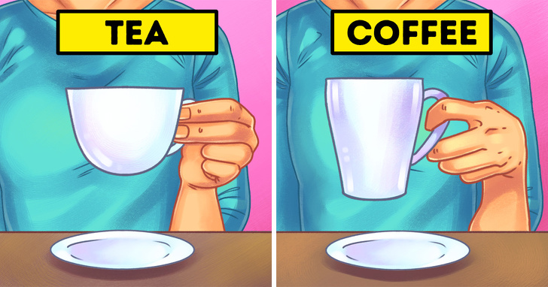
Holding Cup

Slide 36
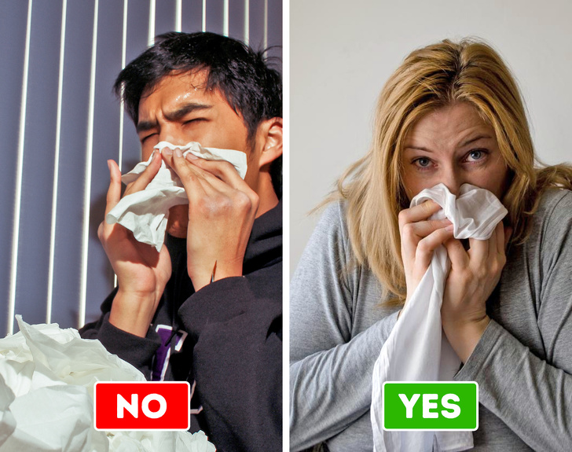
Blow your nose

Slide 37
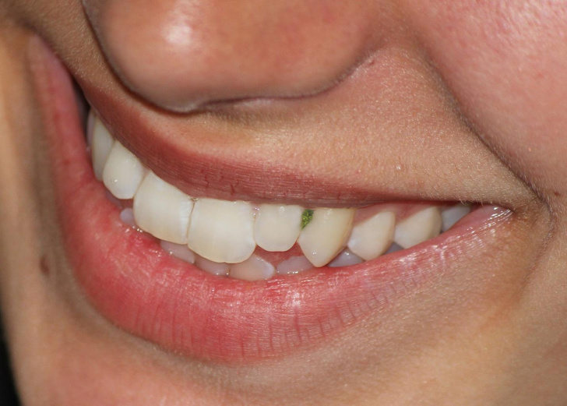
Food stuck in the mouth

Slide 38
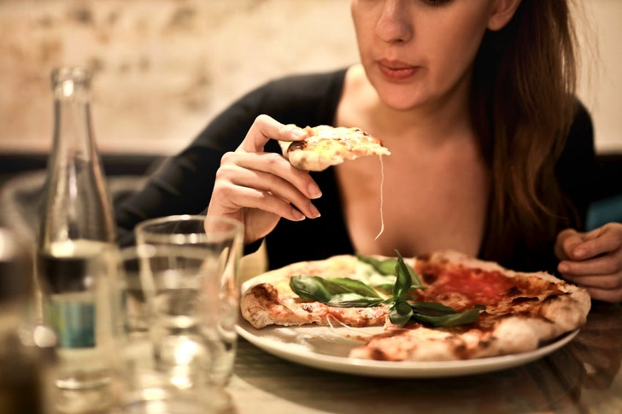
If the food is too hot

Slide 39
Lastly and most importantly
Maintenance of time, punctuality and fulfillment of your commitment diligently and cheerfully
Should make a habit of seeking apology for one’s shortcoming and extending thanks for help

Slide 40
Any Questions ??

Slide 41


